Slide 1

Welcome to Woodlands

Slide 2
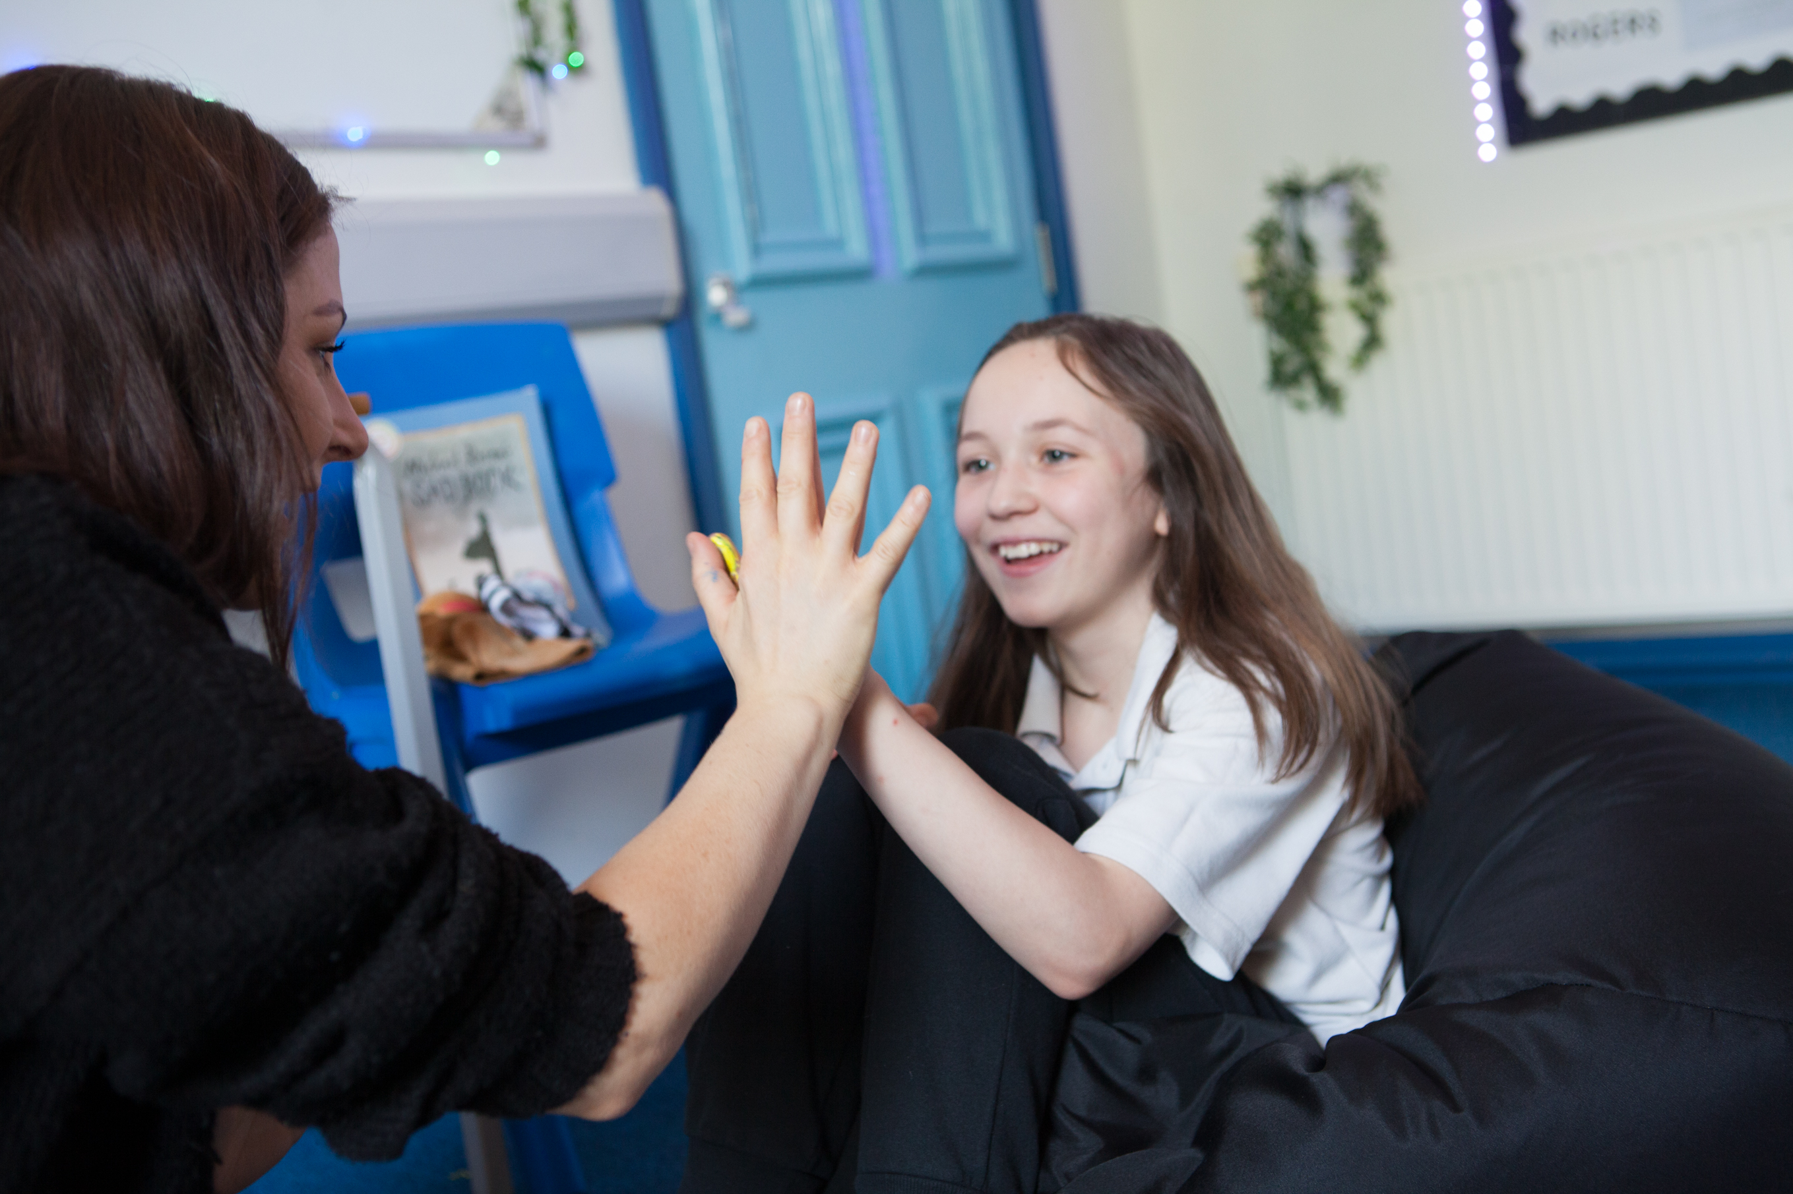
We cannot wait to see you at Woodlands
The transition to Woodlands is an exciting time, full of challenges and experiences for parents and learners. Here at Woodlands, we are committed to ensuring that learners feel ready to meet the challenges in order to feel happy and be successful.

Slide 3
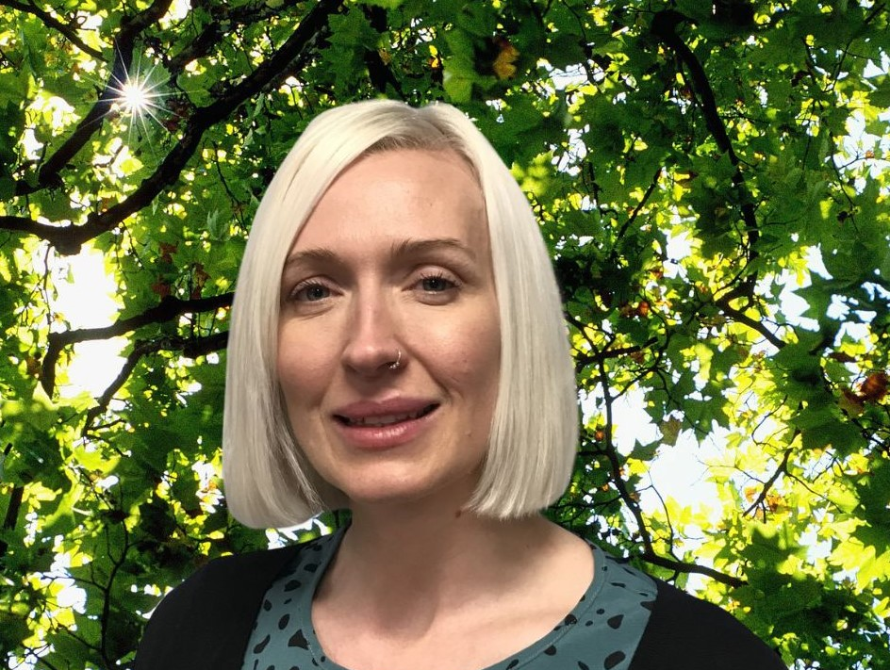
At Woodlands
Sarah
Learning for Life support team are available to support you, and school staff are always available for you with your transition into school.
We will help you develop the skills you need to be able to achieve your EHCP outcomes and aspirations.
Build relationships and trust so that you feel safe.
Reduce any anxieties you may have.
Develop your confidence as a learner.
Director of SEND

Slide 4


Uniform
School uniform is a significant part of school life because it plays an important role in promoting a sense of pride, self-confidence and a feeling of belonging. All these factors positively contribute to pupils’ overall wellbeing.
Our uniform compromises of optional extras to account for any sensory needs learners may have.
All learners receive their first Woodlands Green Sweatshirt and Woodlands White Polo T-Shirt from the school. All other uniform can be purchased from our supplier School Shop Direct
http://schoolshopdirect.co.uk/

Slide 5


Optional Extras
Some learners like our Mid-layer with long sleeves and partial zip instead of a sweatshirt.
You may prefer our black hoodie, learners like having the hood on their jumper.

Slide 6


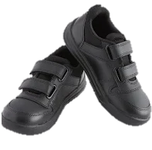
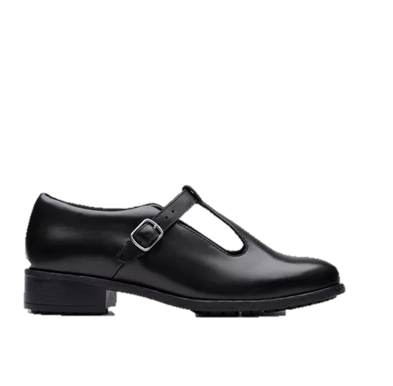
What to wear with my jumper?
Learners can wear plain black joggers; these can be any type as long as they are plain black. There are some available on the school shop website, which learners find comfortable.
Learners wear sensible non-canvas, black shoes or black trainers (no logos)

Slide 7



PE
For PE, learners wear black PE shorts and either a black or green Woodlands PE t-shirt.
Any pair of comfortable trainers
We ask if your PE kit can be brought into school in a PE bag on your PE days.

Slide 8

Vision for our school…
At Woodlands we see and hear every child. We build strong relationships based on respect, empathy and love and use these relationships as a base for safe and positive learning experiences.
We provide a nurturing environment where everyone can grow and flourish. Where all learners are supported to reach their potential, to ‘Be the BEST’ and leave us fully prepared for adulthood. At Woodlands, our holistic approach supports both personal and academic progression, and our learners know that this is where they belong.
This is The Woodlands Way.

Slide 9

Our Moto… Be Your BEST
Be brave
Engage positively
Sensible and safe behaviours at all times
Take responsibility

Slide 10
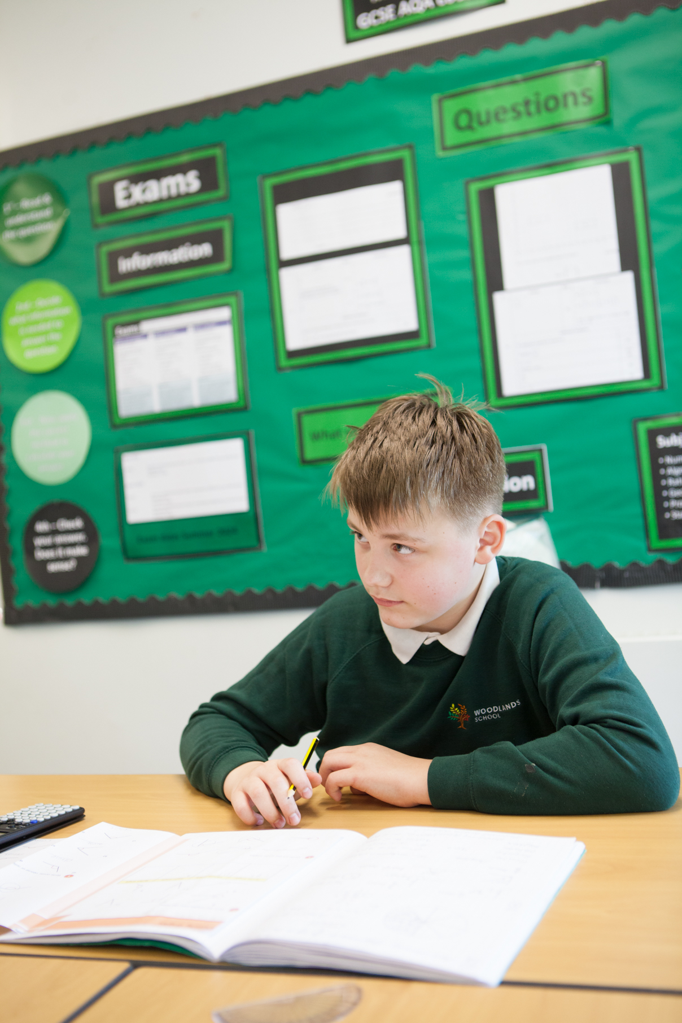
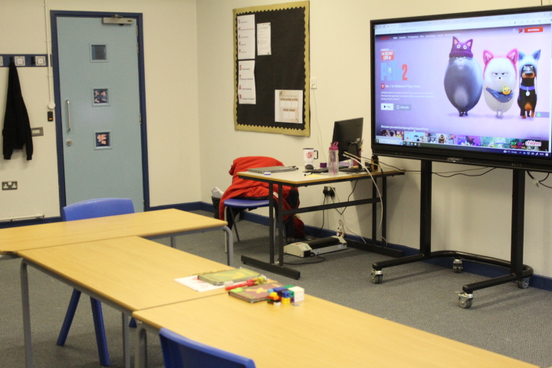
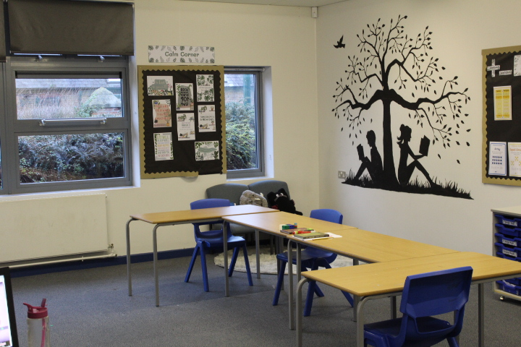
What do we expect from you… in the classroom
Do and be your best in every lesson
Arrive on time and attend all lessons
Be polite and respectful
Ask if you need to leave the room or need some time away
Acorns 2

Slide 11
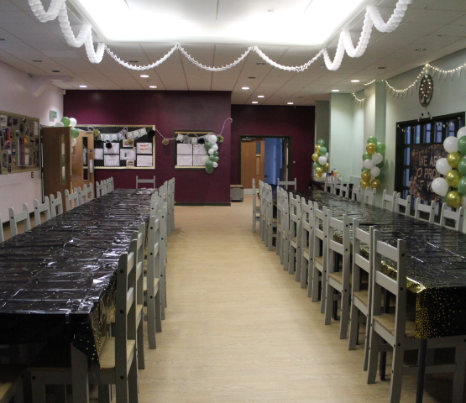
What we expect of you… in the corridor
Move calmly and sensibly
Speak quietly
Look after our environment and spaces

Slide 12
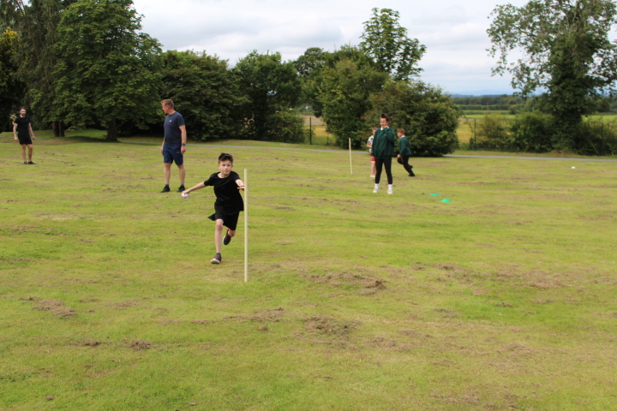
What do we expect from you… outside
Be safe
Stay within school grounds
Respect and look after the environment

Slide 13
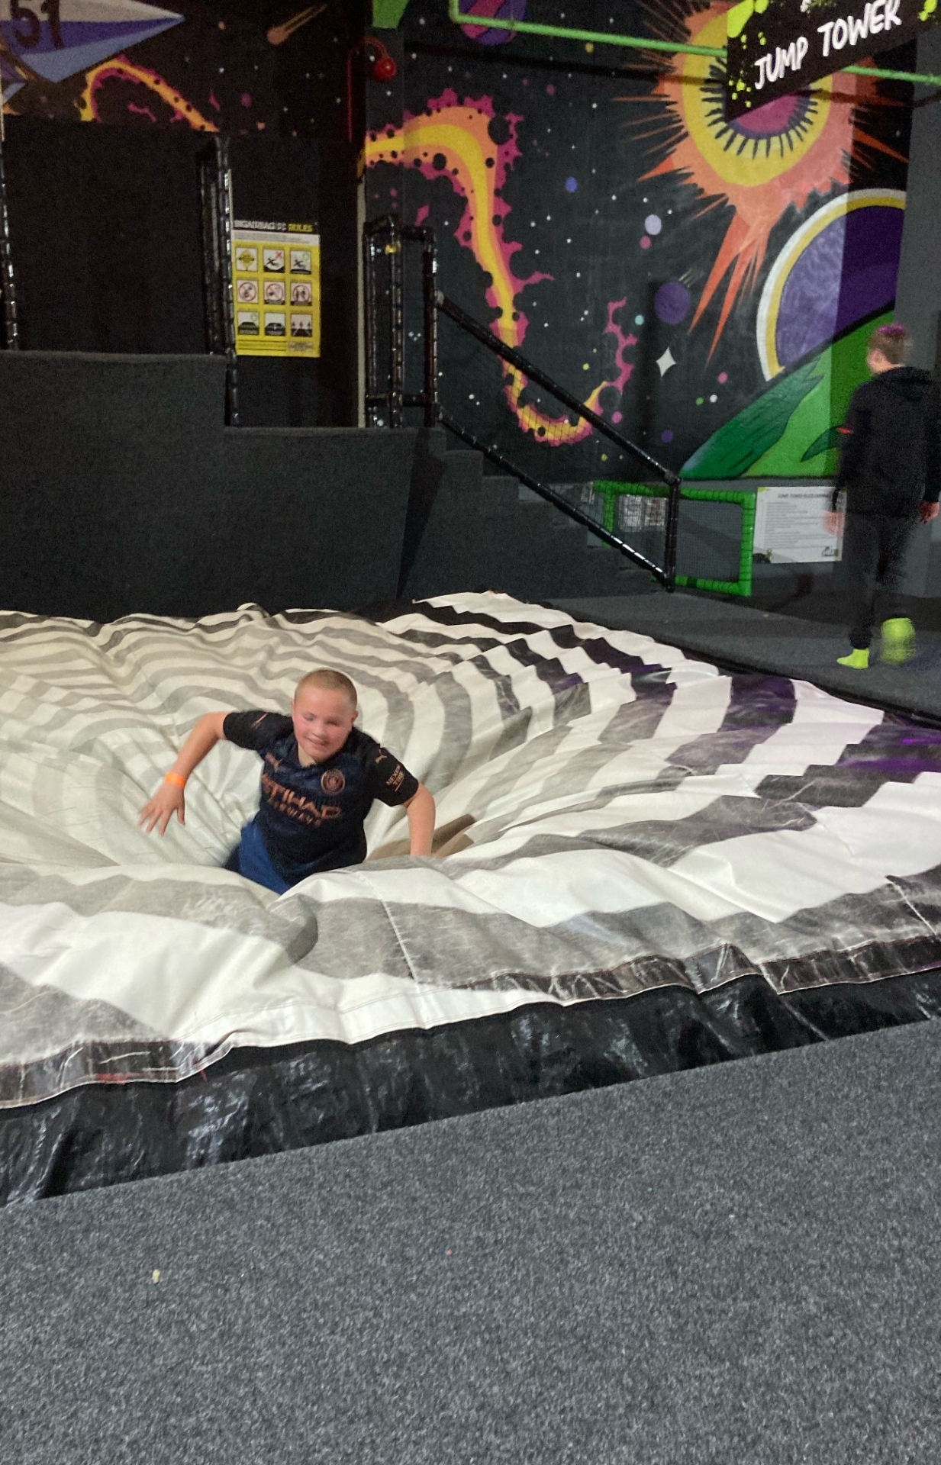
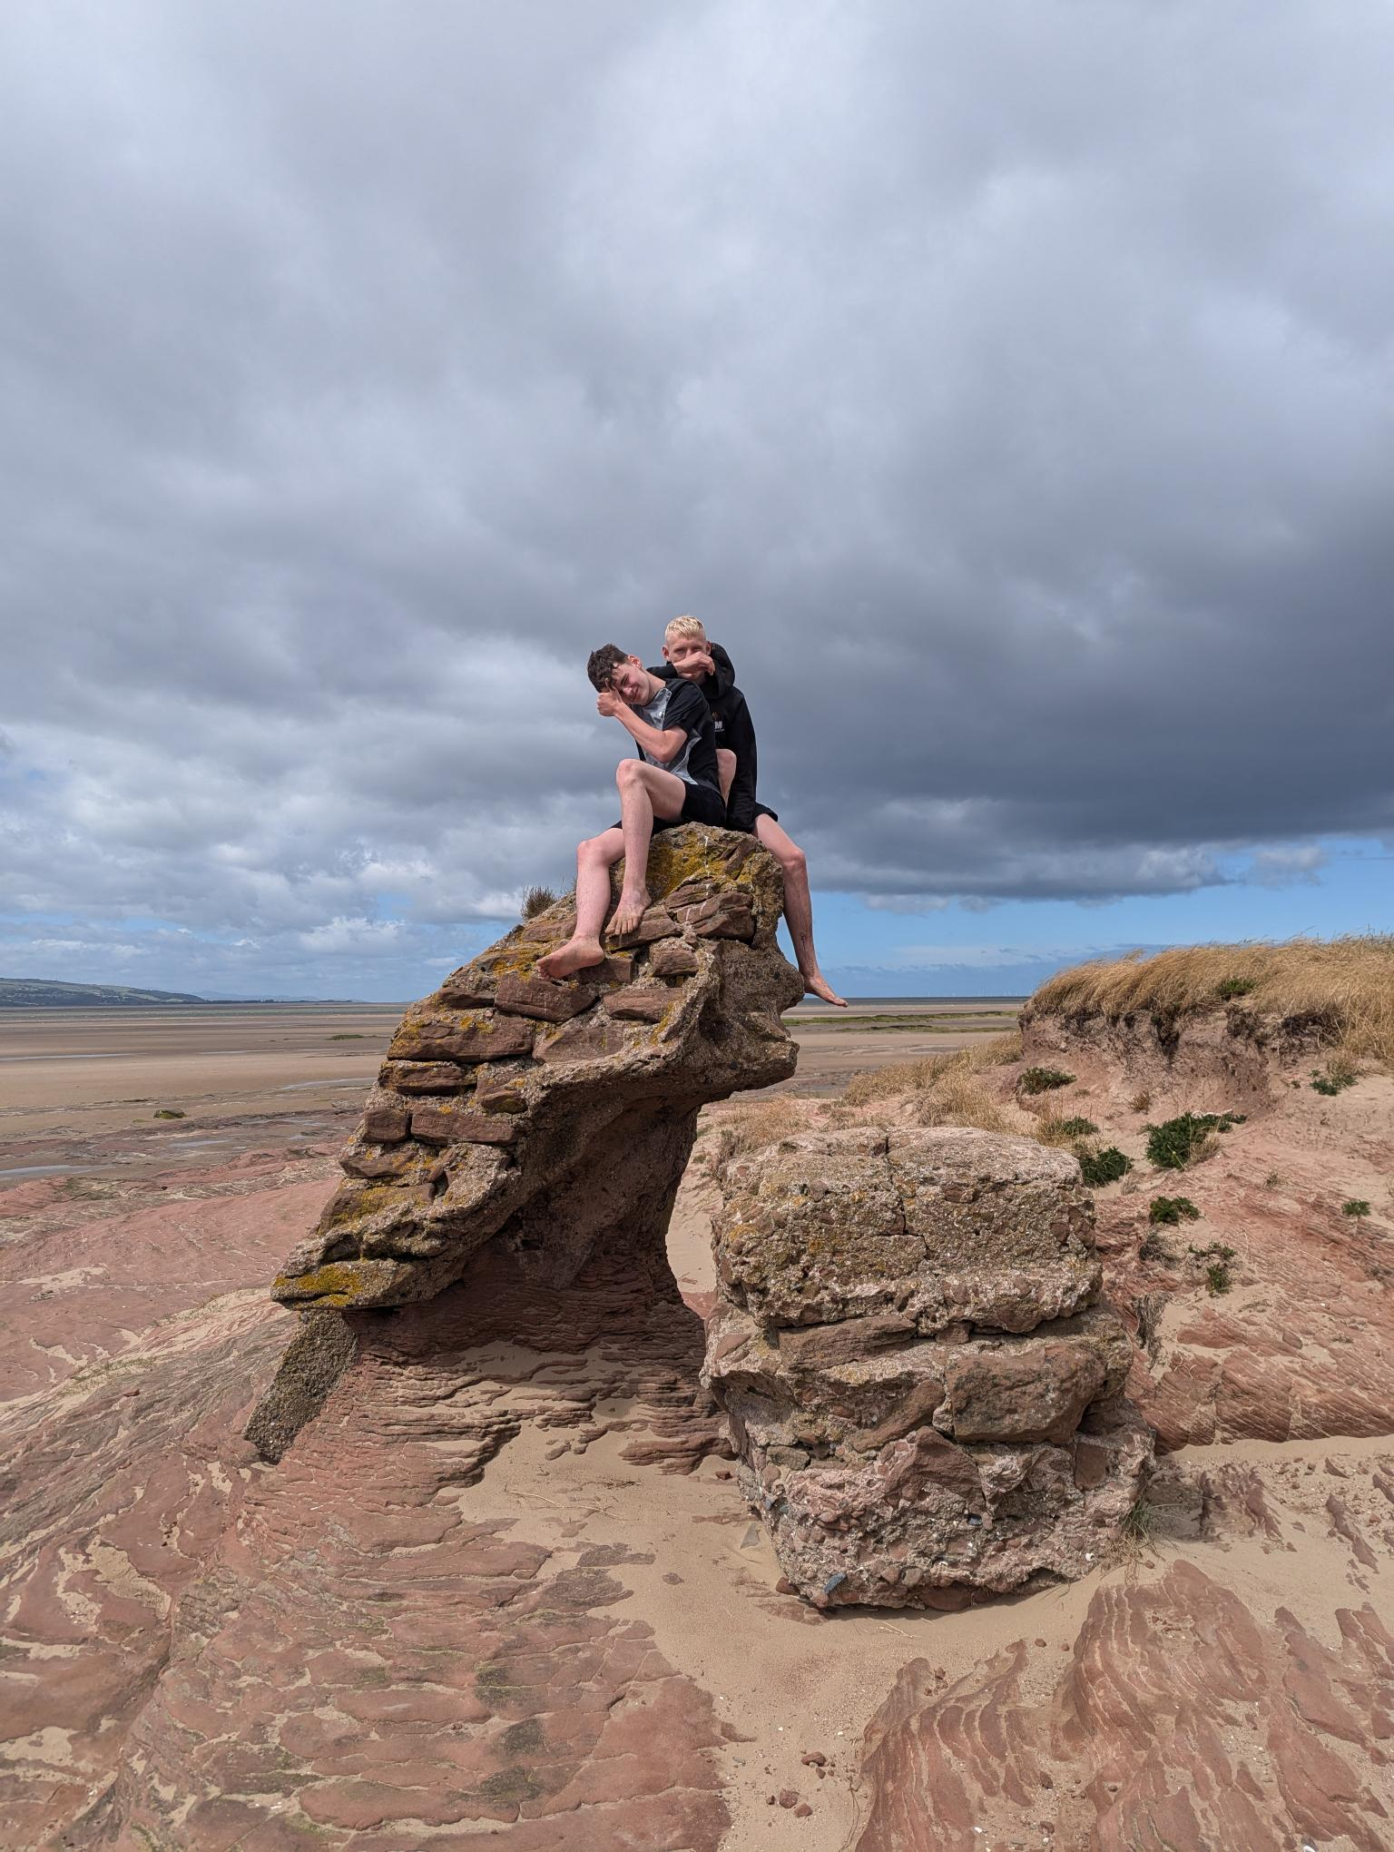
And what do you get when you meet our expectations…
Reward points which will earn you vouchers and trips. The more you earn the more you get. Not for your House but for you.
Each Friday the top 5 students will receive a prize.
You can earn +1 for demonstrating our values - what were they?
Your tutor will keep you updated on how many points you have earned.

Slide 14
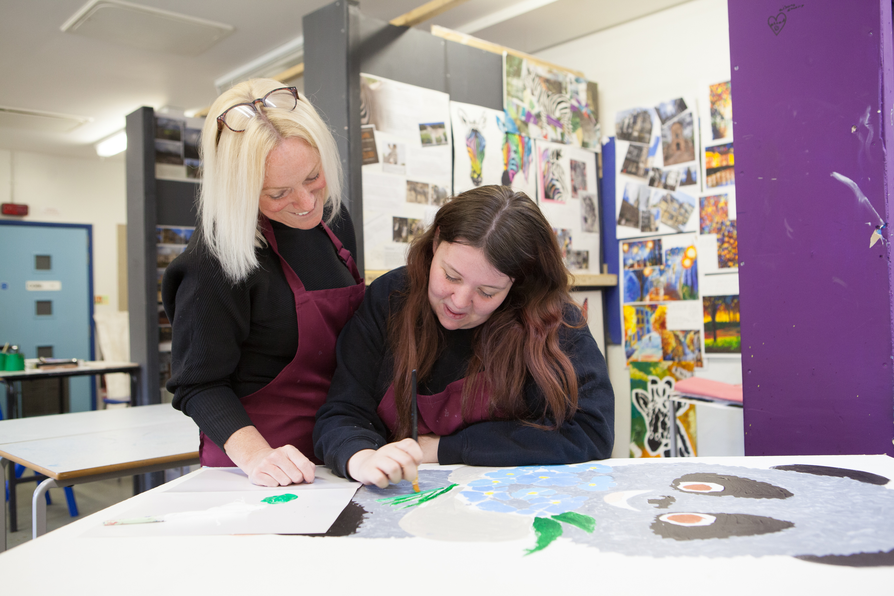
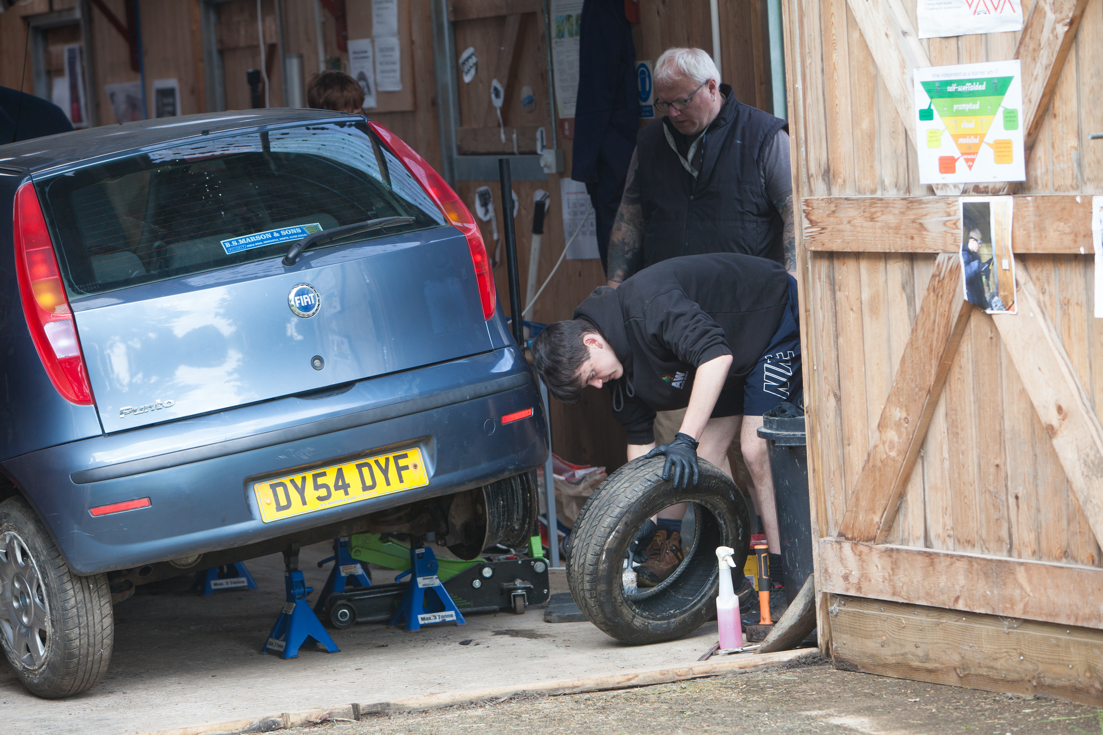
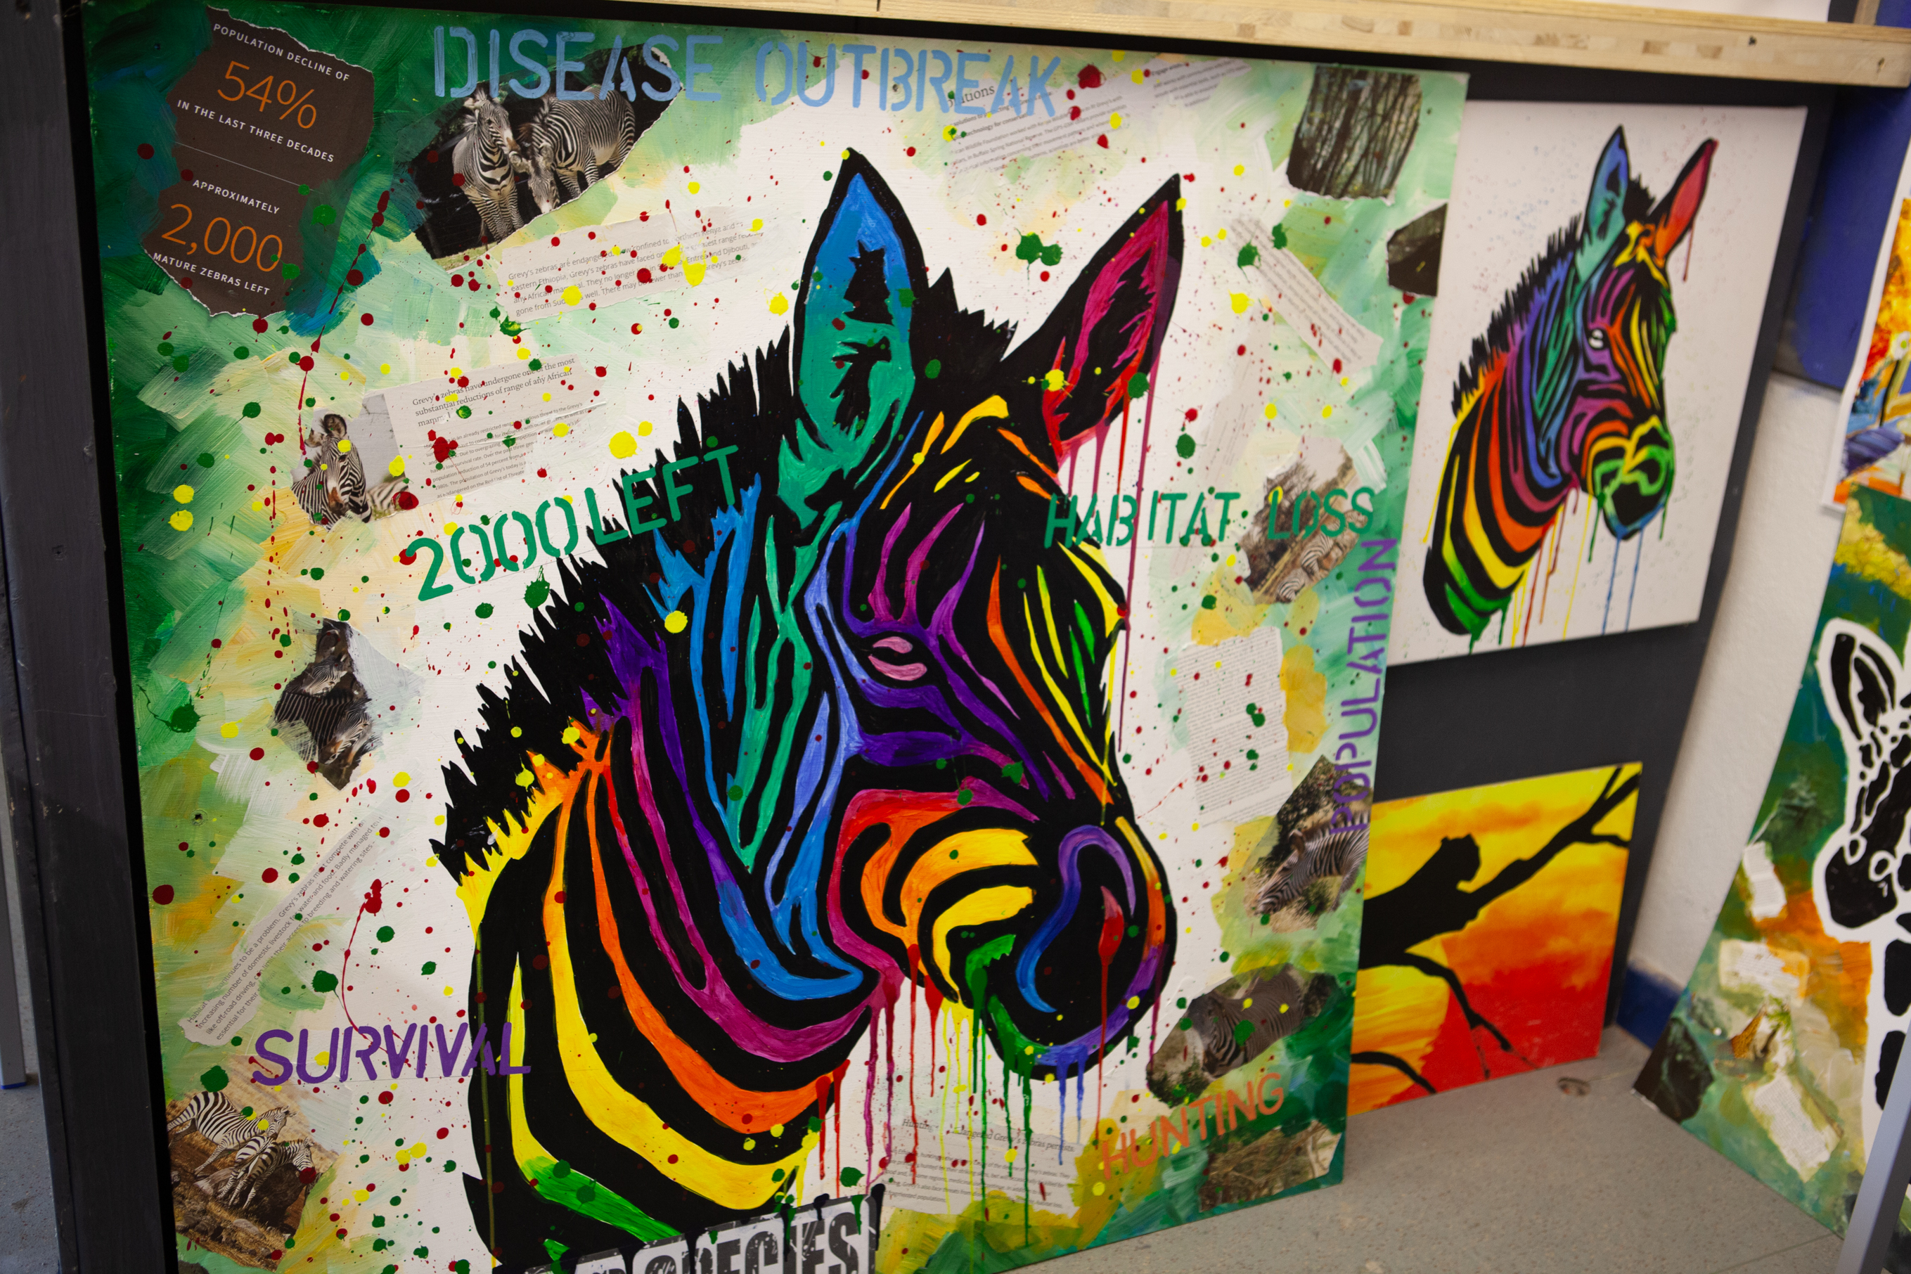
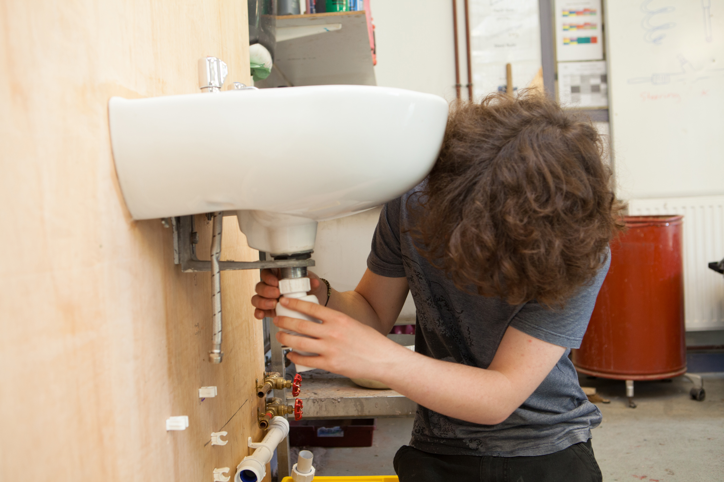
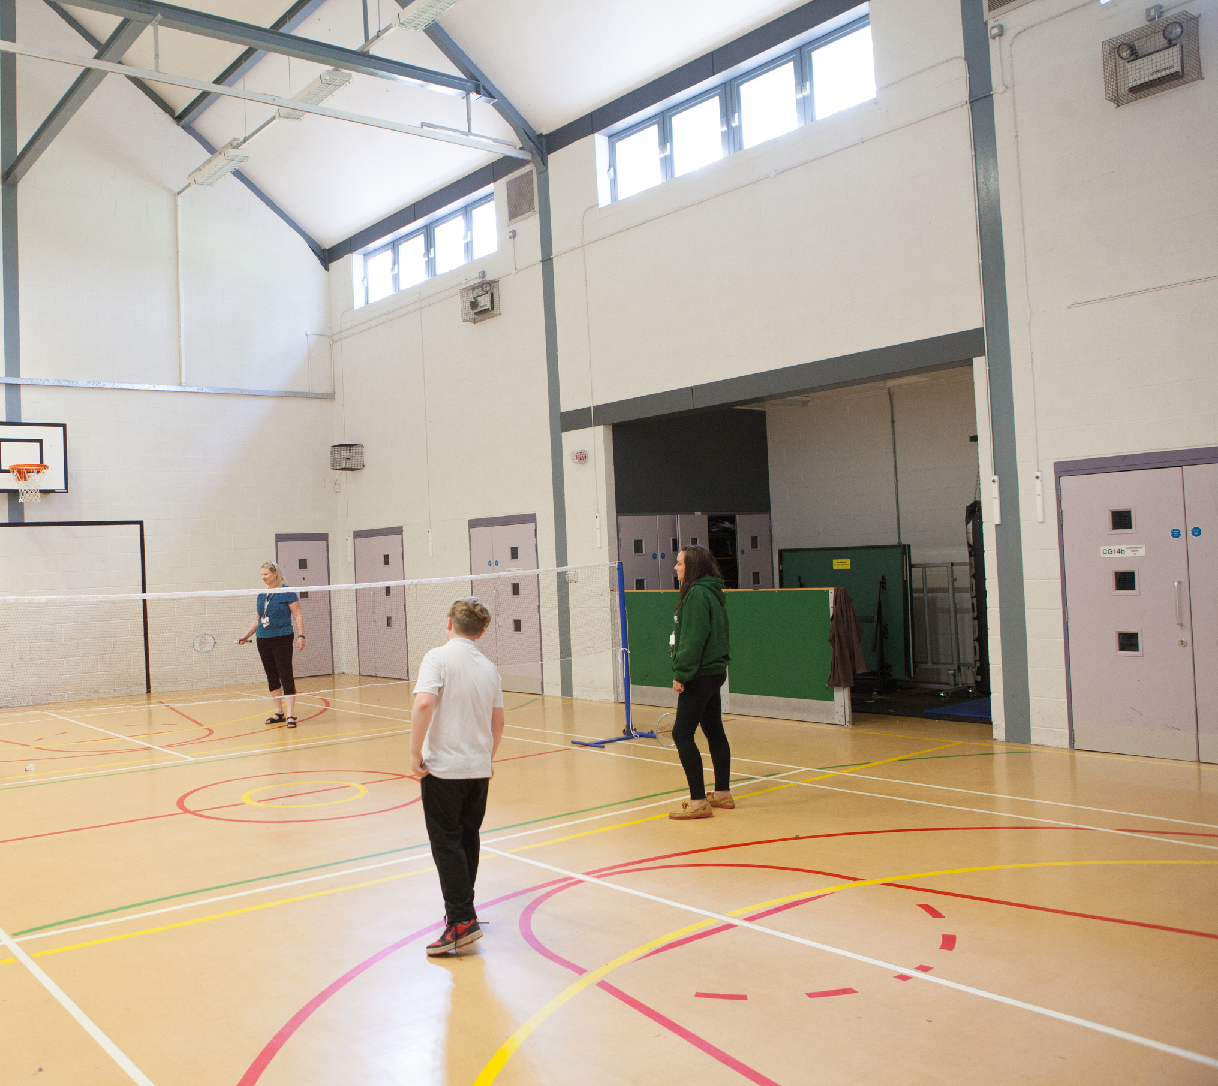
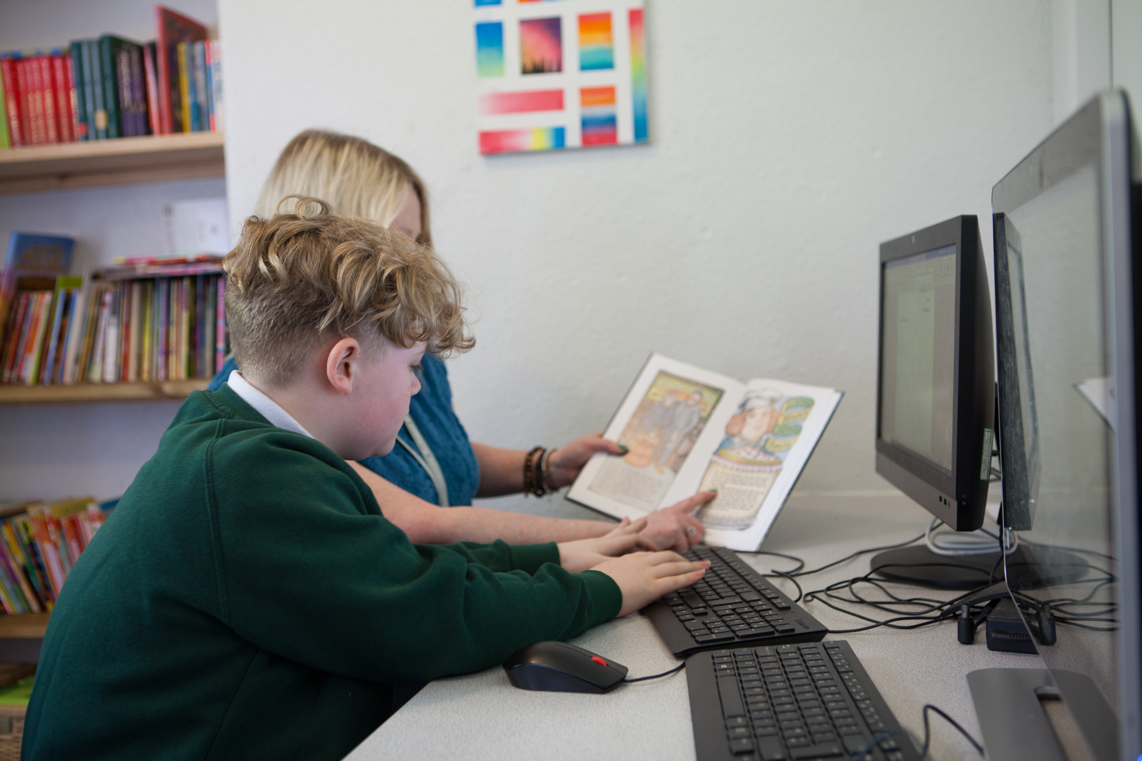
You will have so many opportunities here at Woodlands

Slide 15
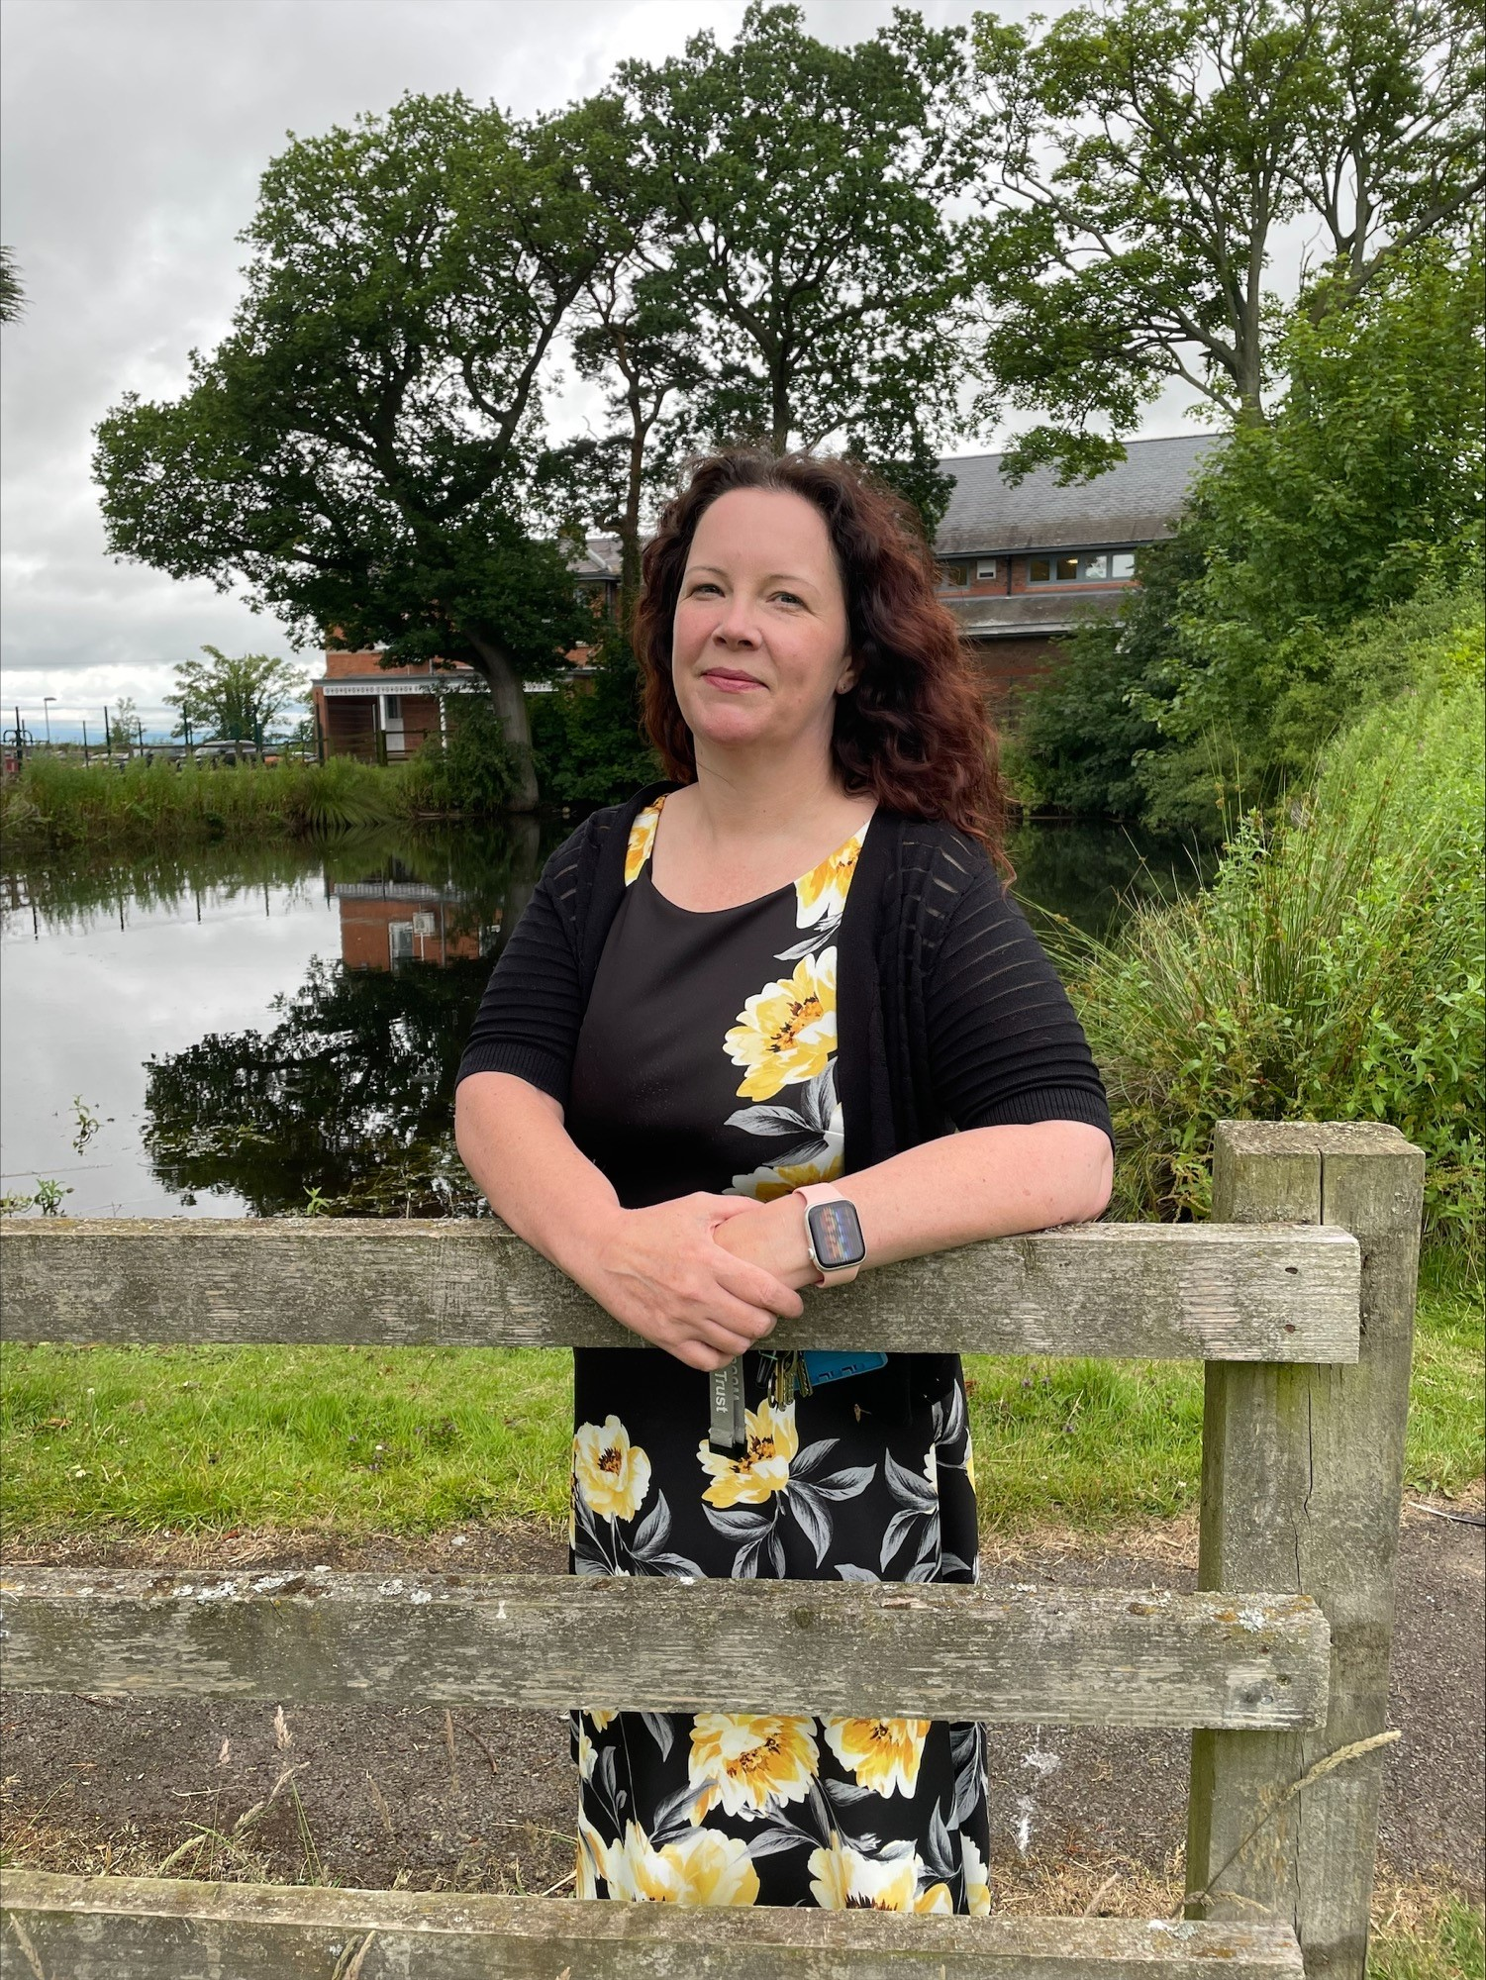
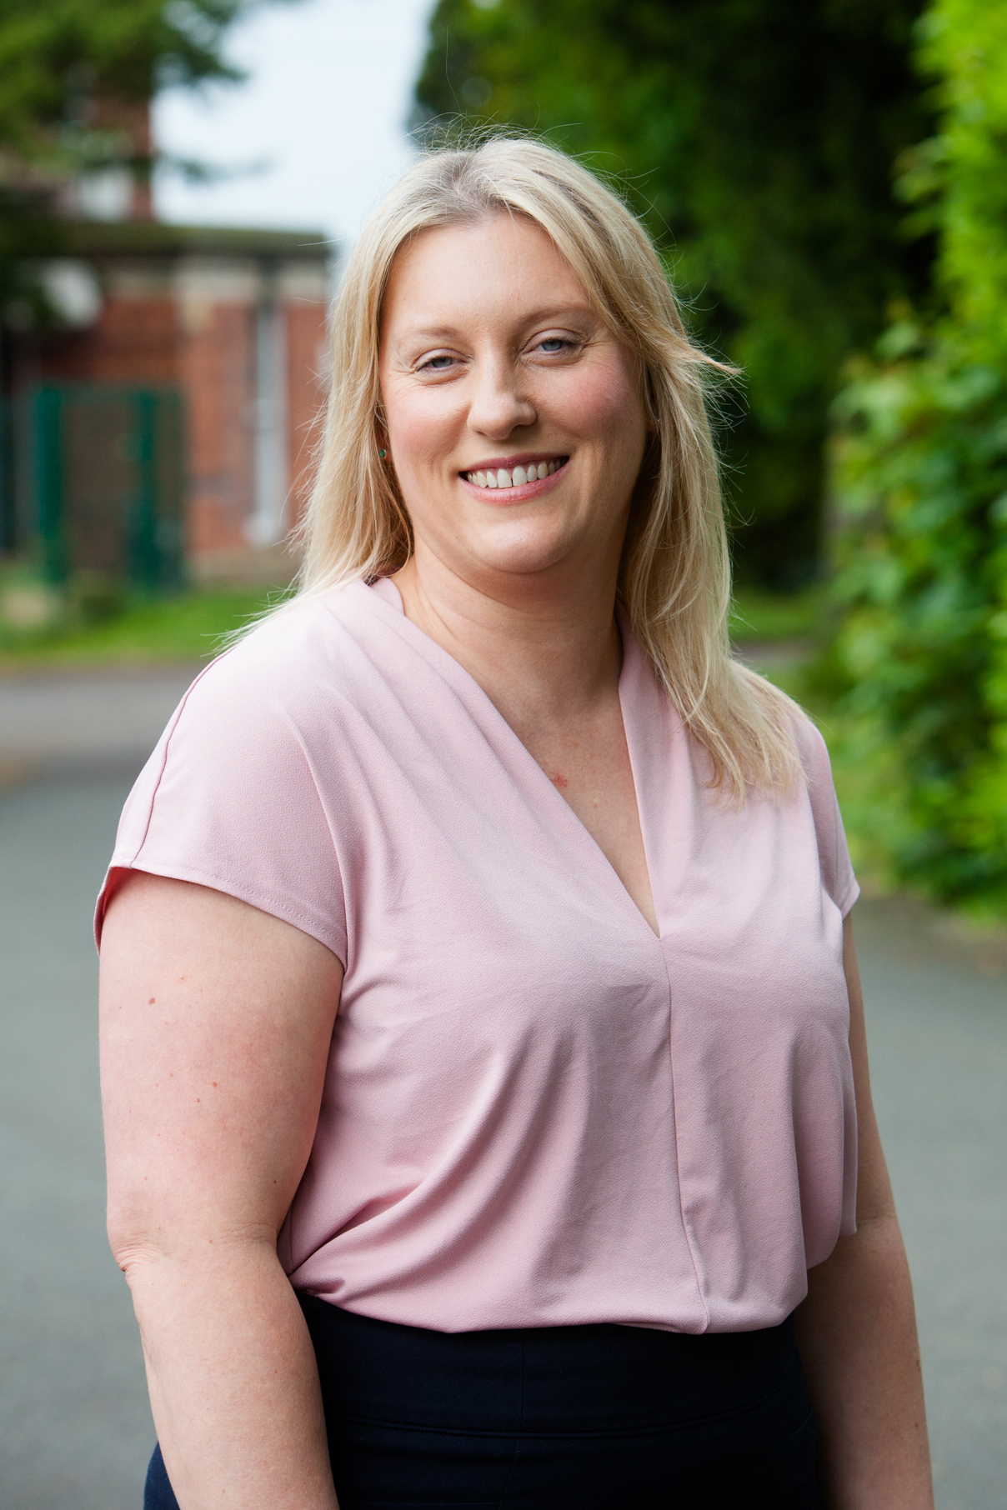

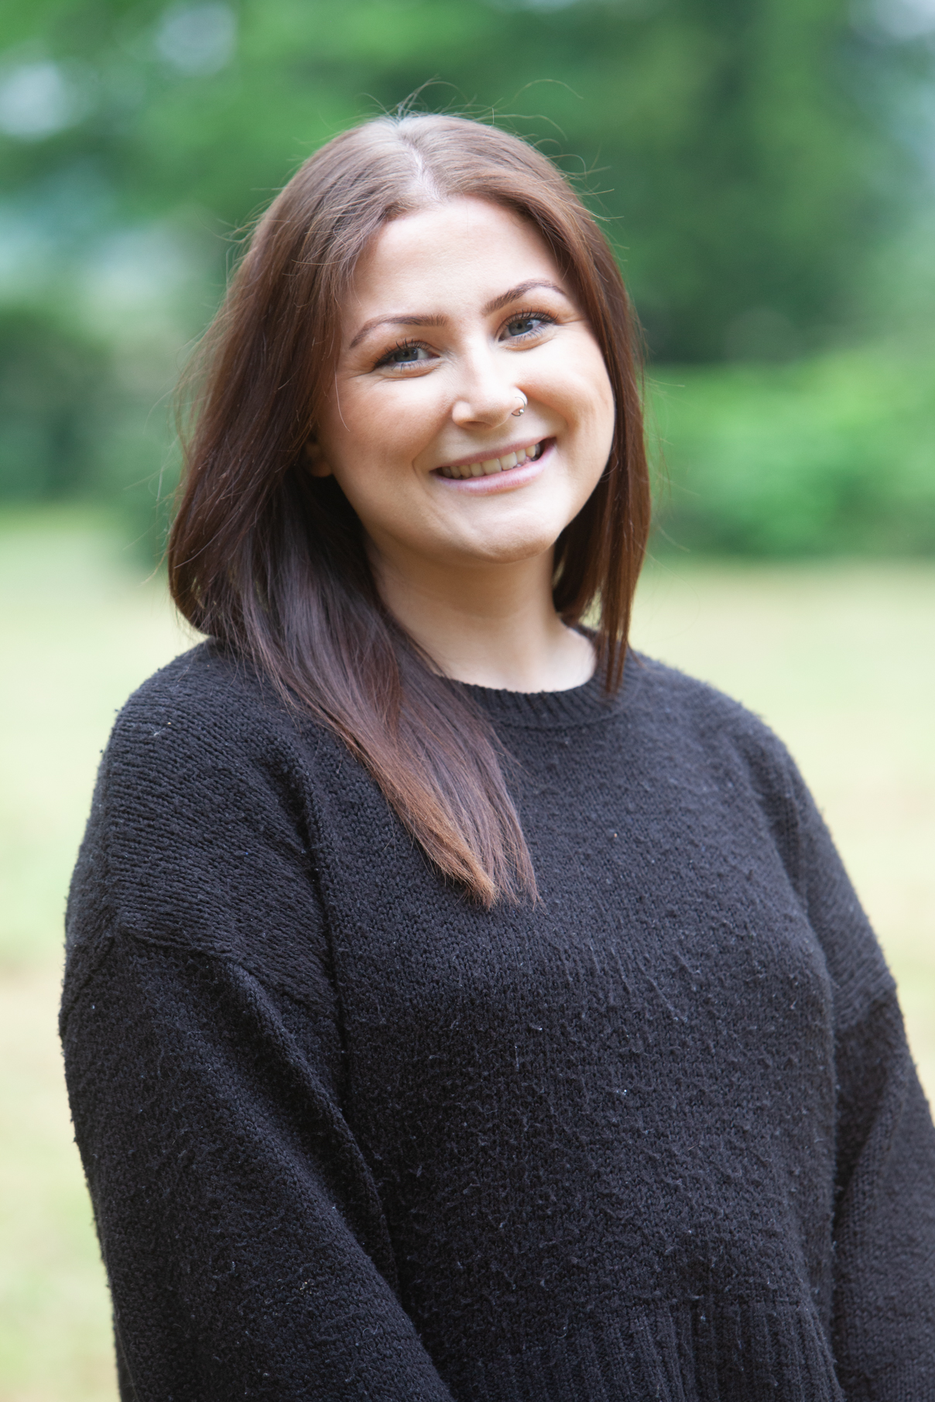
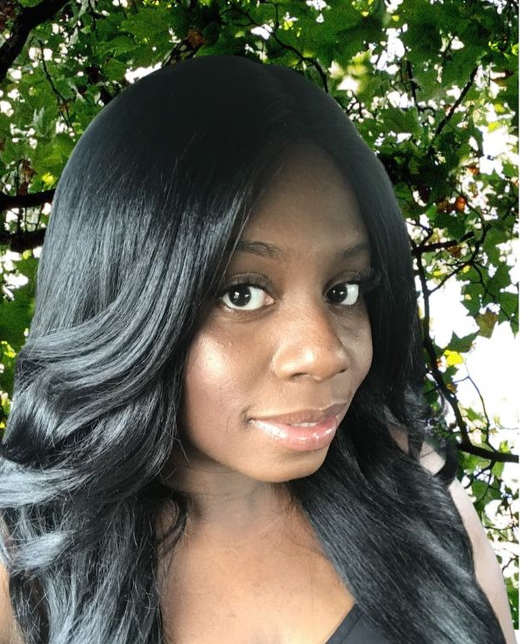

Here to help
All Staff are here to help you, but here are some names and faces so you will be familiar with some of us when you join Woodlands.
Jules Taylor
Headteacher
Alice Arnold
Deputy
Headteacher
Chloe McInnis
Director of Safeguarding
Lydia Shipley
Therapeutic
Play Practitioner
Schmize Badger
Senior Lead for Learner Welfare
Simon Clay Senior Lead for Learner Engagement

Slide 16
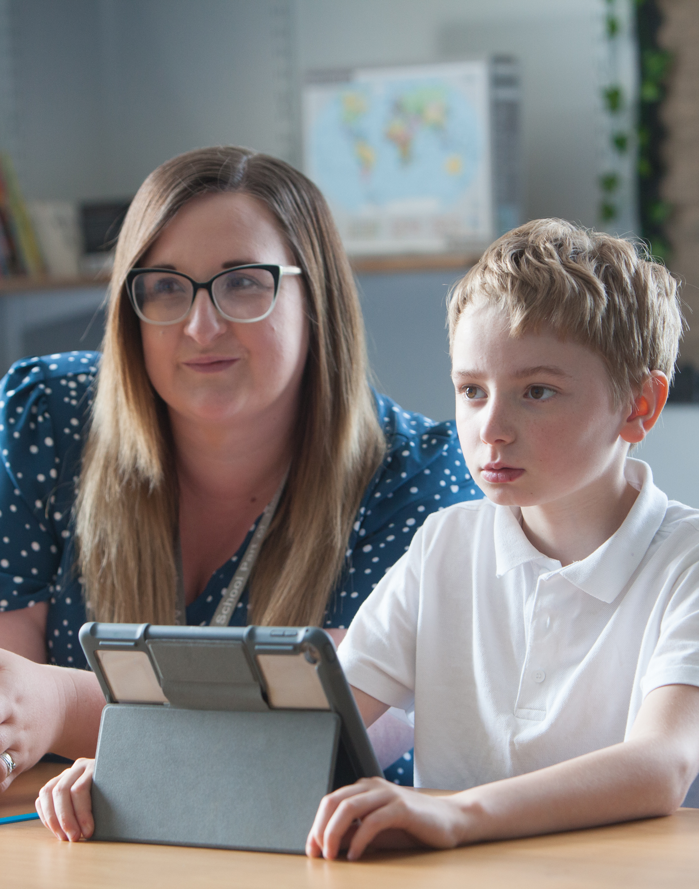
Get in Touch
Our dedicated teaching and teaching support staff ensure that learning is engaging, challenging, interactive (and fun!) whilst our team of site and administration staff ensure that school is safe, information that we share is up to date and that communication is paramount.
If you have any questions, please get in touch
e-mail admin@wdl.mmat.co.uk
Phone: 01939 232372
Website: www.woodlands.school
Follow us on Facebook:
https://www.facebook.com/WoodlandsShropshire/
For SEND Administration or Admissions
please e-mail Rachel Bates
rachel.bates@wdl.mmat.co.uk

